Slide 1
Threaded Programming in Python
CPE 401 / 601
Computer Network Systems
Mehmet Hadi Gunes
Adapted from
Fundamentals of Python: From First Programs Through Data Structures

Slide 2
Objectives
Describe what threads do and how they are manipulated in an application
Code an algorithm to run as a thread
Use conditions to solve a simple synchronization problem with threads
Use IP addresses, ports, and sockets to create a simple client/server application on a network
Decompose a server application with threads to handle client requests efficiently
Restructure existing applications for deployment as client/server applications on a network

Slide 3
Threads
In Python, a thread is
  an object like any other in that it can hold data,
  be run with methods,
  be stored in data structures, and
  be passed as parameters to methods
A thread can also be executed as a process
  Before it can execute, a thread’s class must implement a run method
During its lifetime, a thread can be in various states

Slide 4
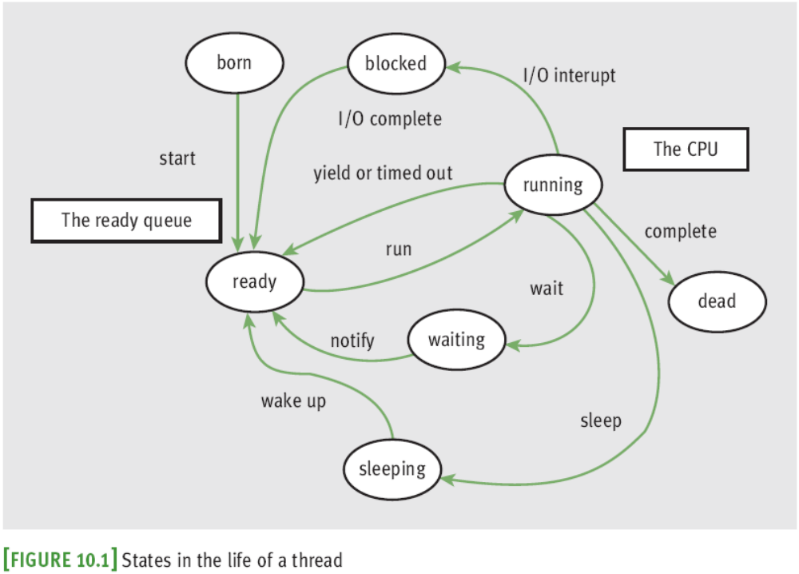
Threads (continued)

Slide 5
Threads (continued)
A thread remains inactive until start method runs
  Thread is placed in the ready queue
  Newly started thread’s run method is also activated
A thread can lose access to the CPU:
  Time-out (process also known as time slicing)
  Sleep
  Block
  Wait
Process of saving/restoring a thread’s state is called a context switch

Slide 6
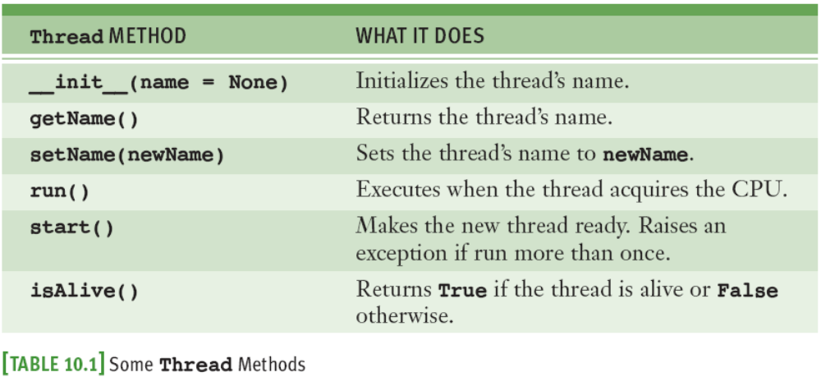
Threads (continued)
A thread’s run method is invoked automatically by start

Slide 7
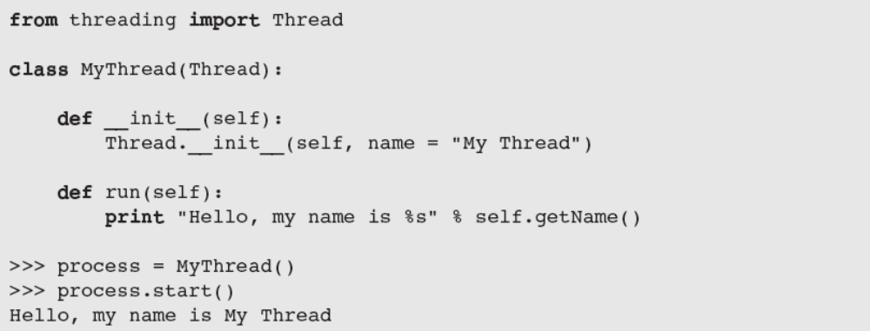
Threads (continued)
Most common way to create a thread is to define a class that extends the class threading.Thread

Slide 8
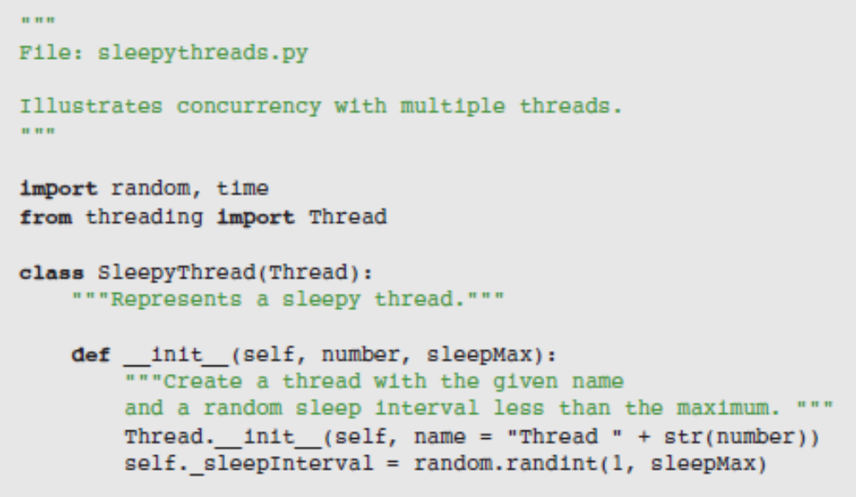
Sleeping Threads
The function time.sleep puts a thread to sleep for the specified number of seconds

Slide 9
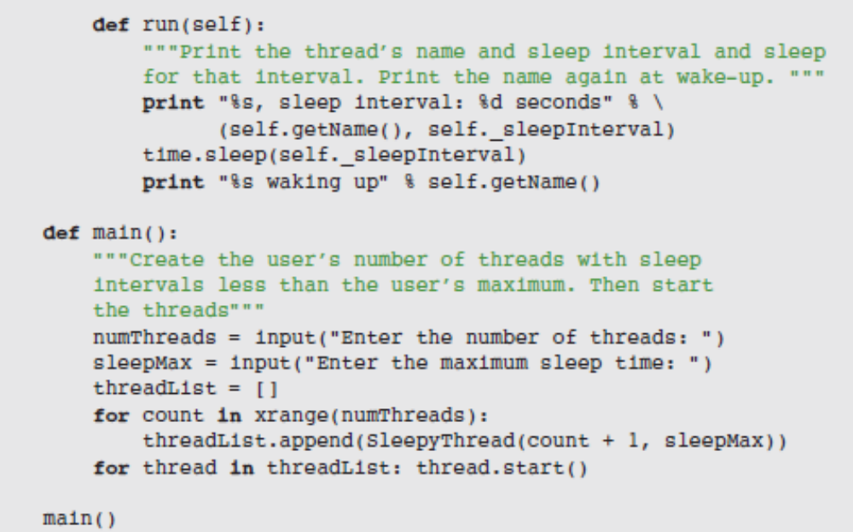
Sleeping Threads

Slide 10
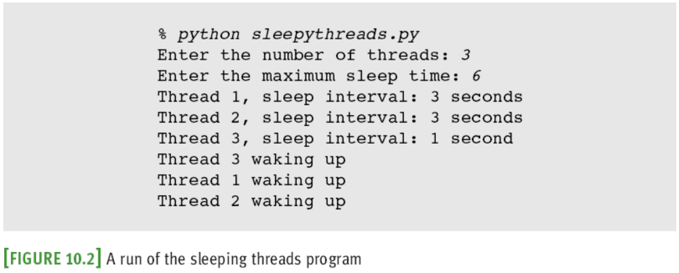
Sleeping Threads

Slide 11
Producer, Consumer, and Synchronization
Threads that interact by sharing data are said to have a producer/consumer relationship
Example: an assembly line in a factory
  A producer must produce each item before a consumer consumes it
  Each item must be consumed before the producer produces the next item
  A consumer must consume each item just once
We will simulate a producer/consumer relationship:
  Will share a single data cell with an integer

Slide 12
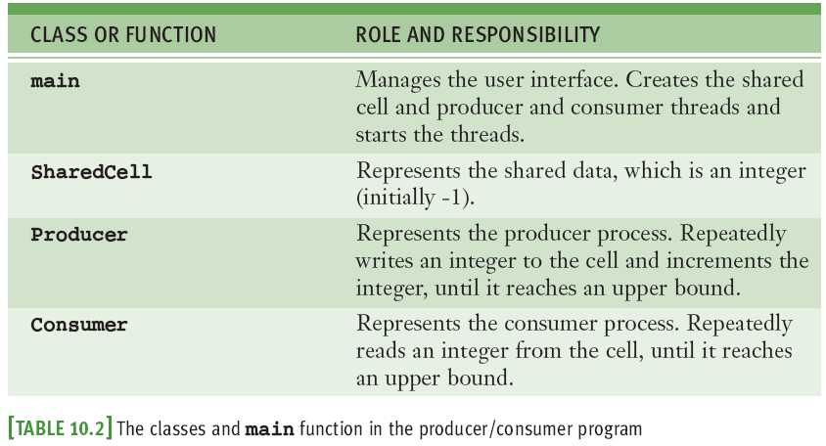
Producer, Consumer, and Synchronization

Slide 13
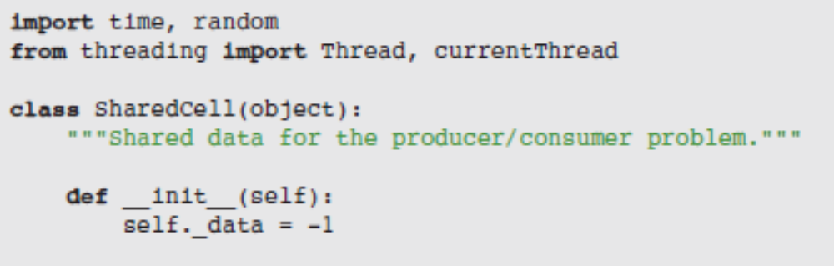
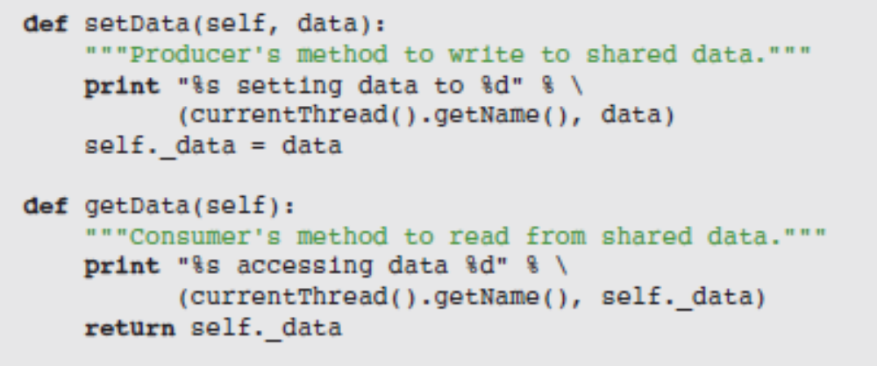
Producer, Consumer, and Synchronization

Slide 14
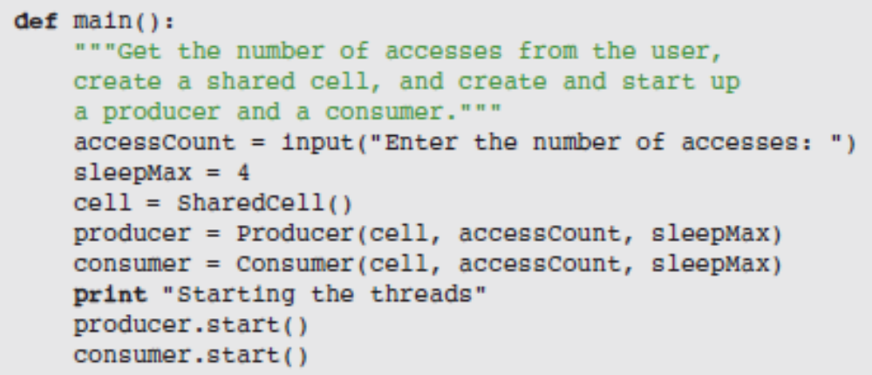
Producer, Consumer, and Synchronization

Slide 15
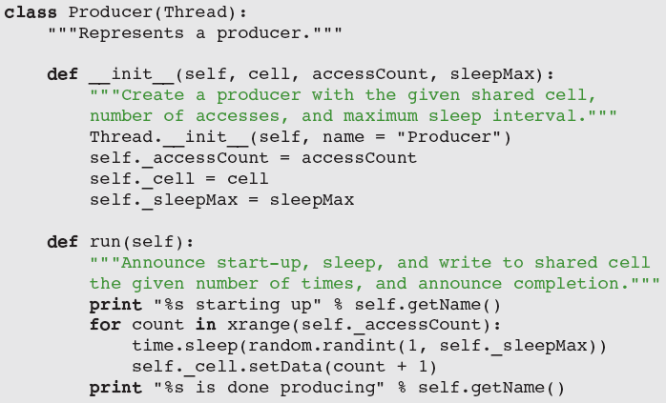
Producer, Consumer, and Synchronization

Slide 16
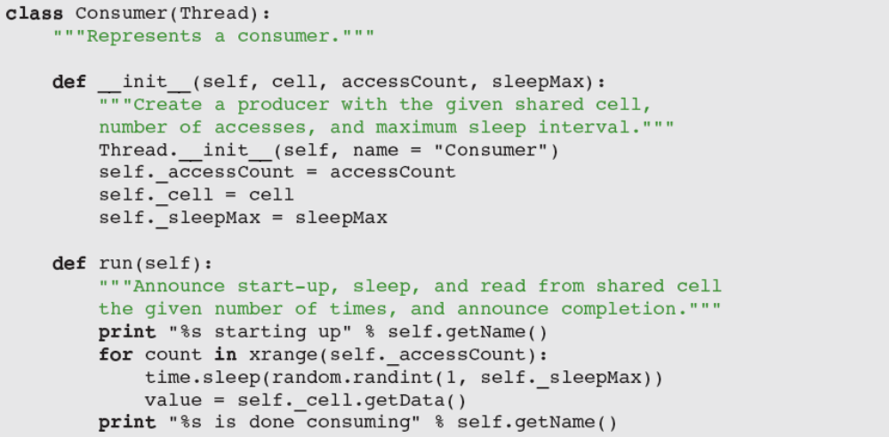
Producer, Consumer, and Synchronization

Slide 17
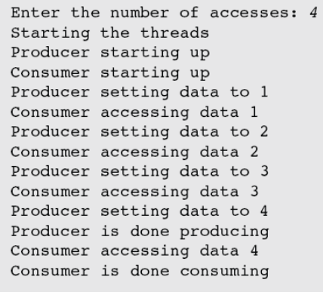
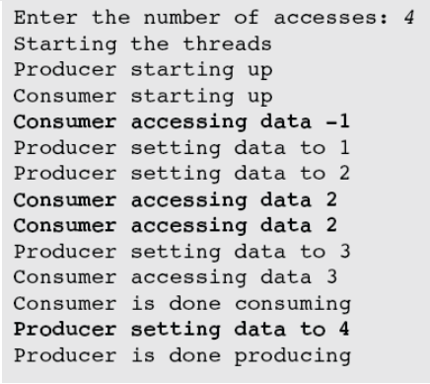
Producer, Consumer, and Synchronization
Threads sleep for random intervals

Slide 18
Producer, Consumer, and Synchronization
Synchronization problems may arise:
  Consumer accesses the shared cell before the producer has written its first datum
  Producer then writes two consecutive data (1 and 2) before the consumer has accessed the cell again
  Consumer accesses data 2 twice
  Producer writes data 4 after consumer is finished
Solution: synchronize producer/consumer threads
  States of shared cell: writeable or not writeable

Slide 19
Producer, Consumer, and Synchronization
Solution (continued):
  Add two instance variables to SharedCell: a Boolean flag (_writeable) and an instance of threading.Condition
A Condition maintains a lock on a resource

Slide 20
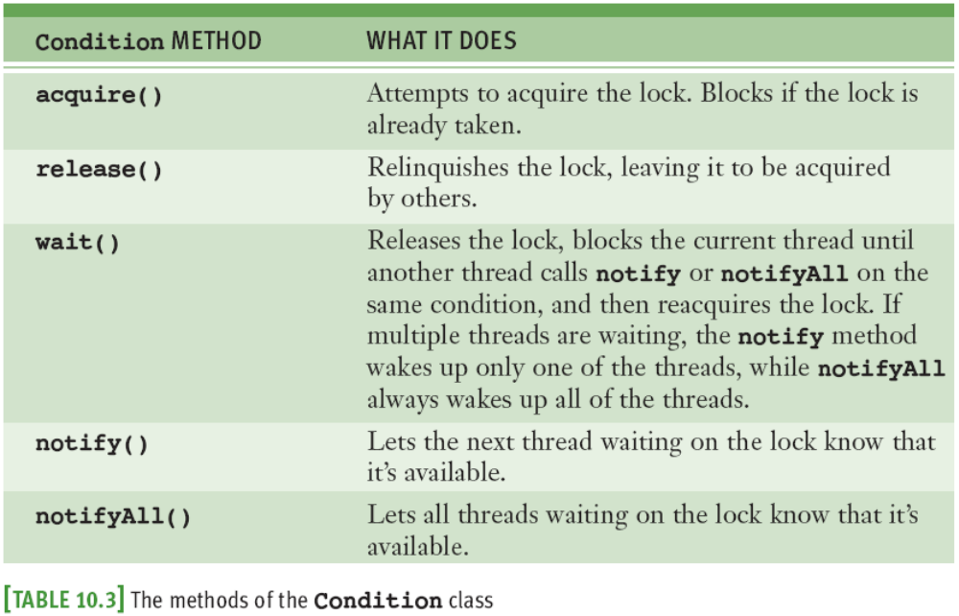
Producer, Consumer, and Synchronization

Slide 21
Producer, Consumer, and Synchronization
Pattern for accessing a resource with a lock:
  Run acquire on the condition.
  While it’s not OK to do the work
  Run wait on the condition.
  Do the work with the resource.
  Run notify on the condition.
  Run release on the condition.

Slide 22
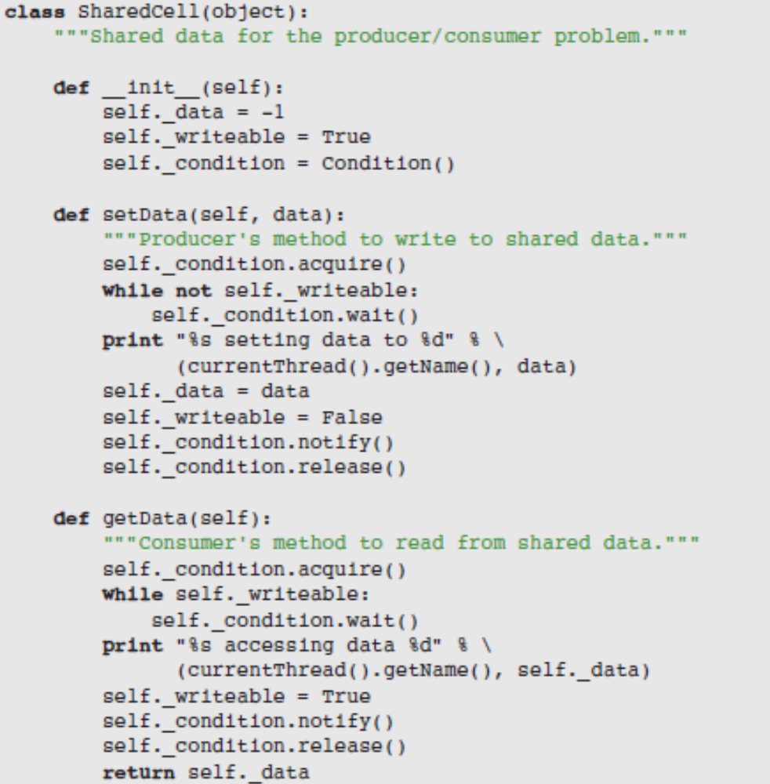
Producer, Consumer, and Synchronization

Slide 23
Summary
Threads allow the work of a single program to be distributed among several computational processes
  States: born, ready, executing, sleeping, and waiting
After a thread is started, it goes to the end of the ready queue to be scheduled for a turn in the CPU
A thread may give up CPU when timed out, sleeps, waits on a condition, or finishes its run method
When a thread wakes up, is timed out, or is notified that it can stop waiting, it returns to the rear of the ready queue
Thread synchronization problems can occur when two or more threads share data
A server can handle several clients concurrently by assigning each client request to a separate handler thread

